Slide 1
Week 16-17
Graph representations for visual recognition

Slide 2
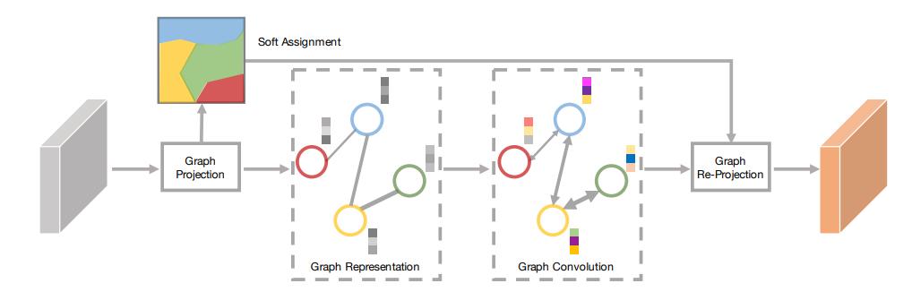
Learning Graph Representations for visual recognition
Graph Projection
Graph Convolutional Unit

Slide 3
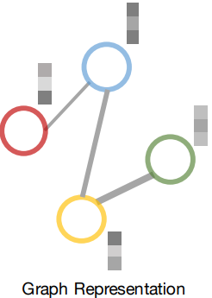
Graph Projection
Cluster pixels with similar feature.
Measure distance between vertices

Slide 4
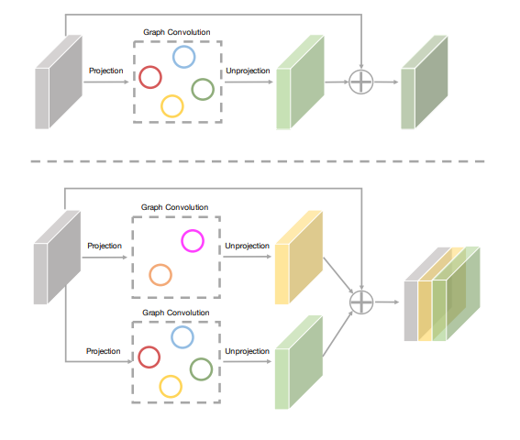
Graph Convolutional Unit

Slide 5
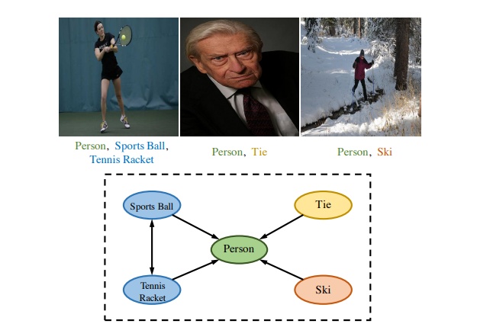
Multi-Label Image Recognition With Graph Convolutional Networks
Correlation Matrix
Architecture

Slide 6
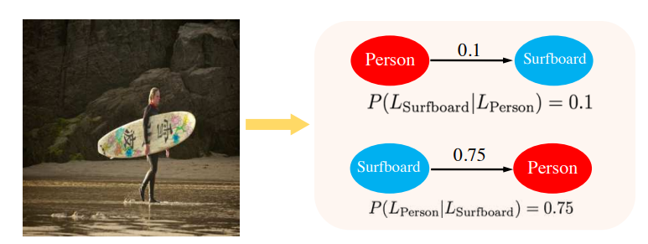
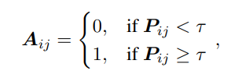
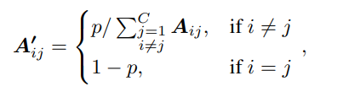
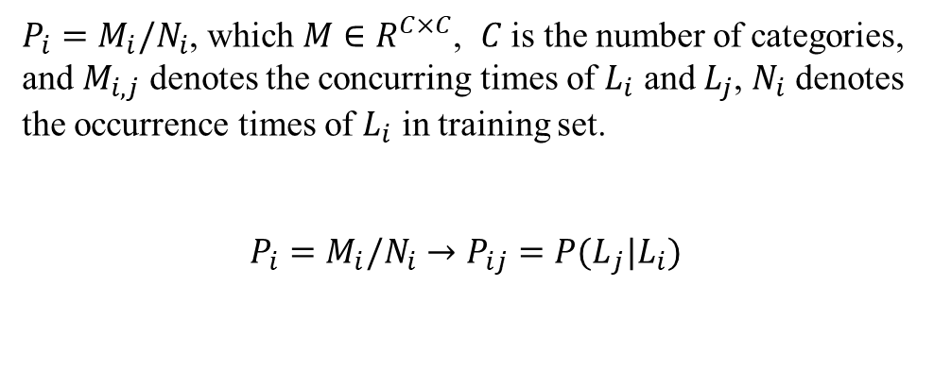
Correlation Matrix
$P_{i}=M_{i}/N_{i}$, which $M∈R^{C×C}$, $C$ is the number of categories, and $M_{i,j}$ denotes the concurring times of $L_{i}$ and $L_{j}$, $N_{i}$ denotes the occurrence times of $L_{i}$ in training set.
$P_{i}=M_{i}/N_{i}→$ $P_{ij}={P(L}_{j}|L_{i})$

Slide 7
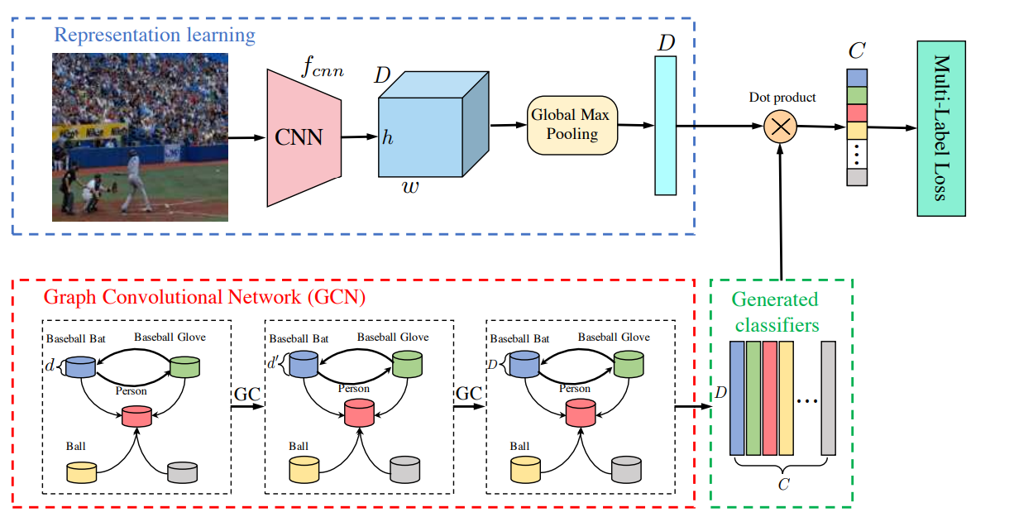
Architecture

Slide 8
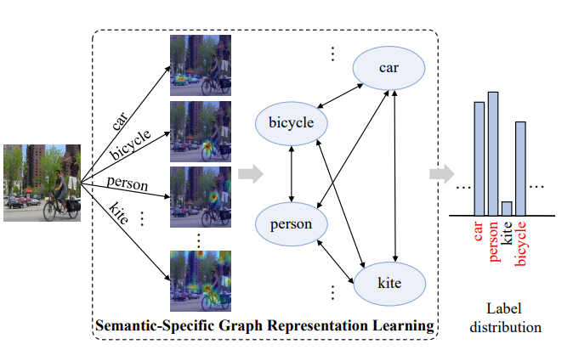
Learning Semantic-Specific Graph Representation for Multi-Label Image Recognition
Semantic Decoupling
Semantic Interaction
Architecture

Slide 9
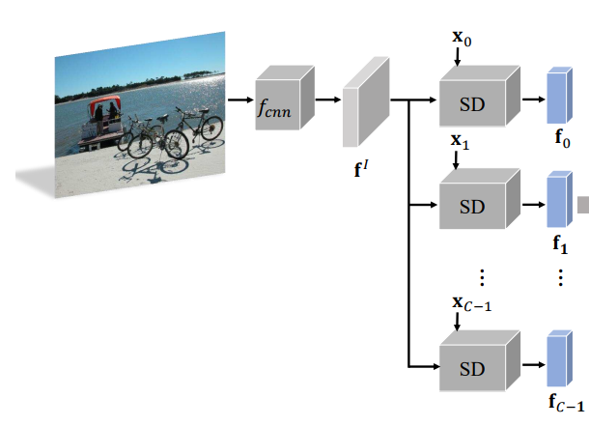
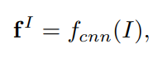
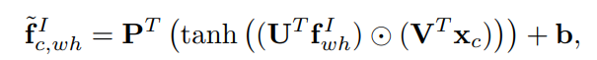
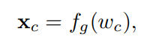
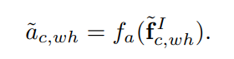
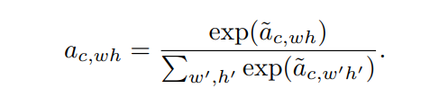
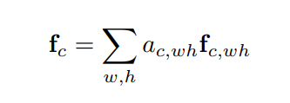
Semantic Decoupling
Semantic word

Slide 10
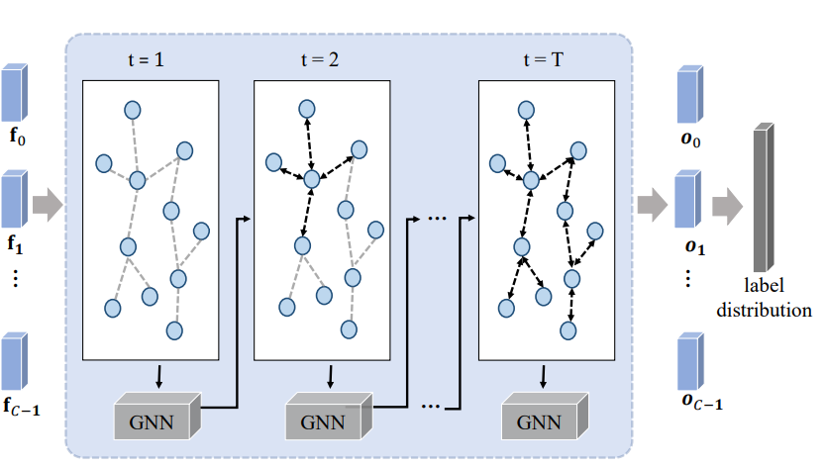
Semantic Interaction

Slide 11
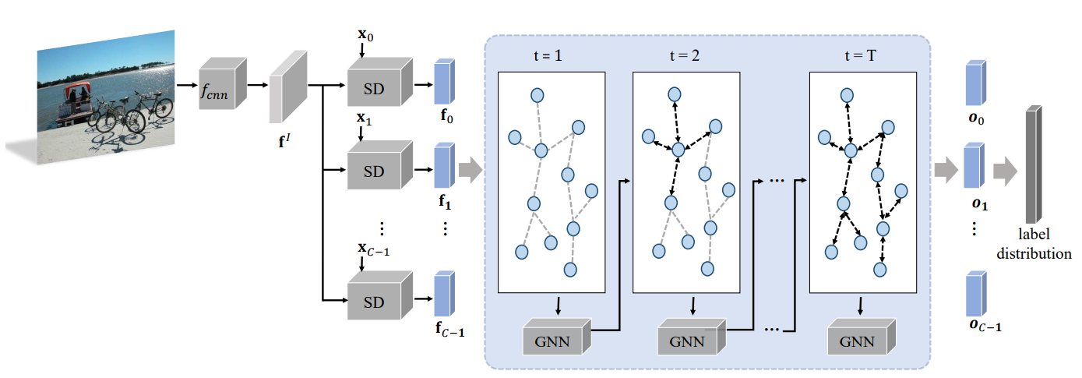
Architecture

Slide 12
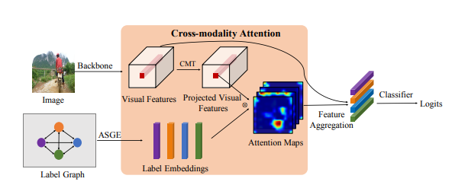
Cross-Modality Attention with Semantic Graph Embedding for Multi-Label Classification
Adjacency-based Similarity Graph Embedding
Cross-Modality Attention

Slide 13
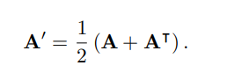
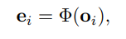
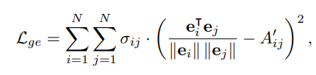

Adjacency-based Similarity Graph Embedding
Conditional Probability as weight in $A$
Label as node
Neural network to project label embedding set.

Slide 14
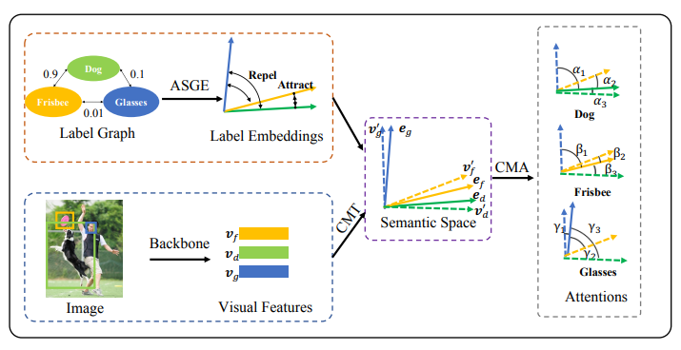
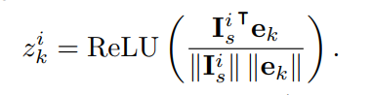
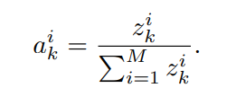
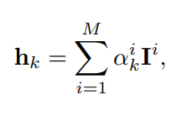
Cross-Modality Attention

Slide 15
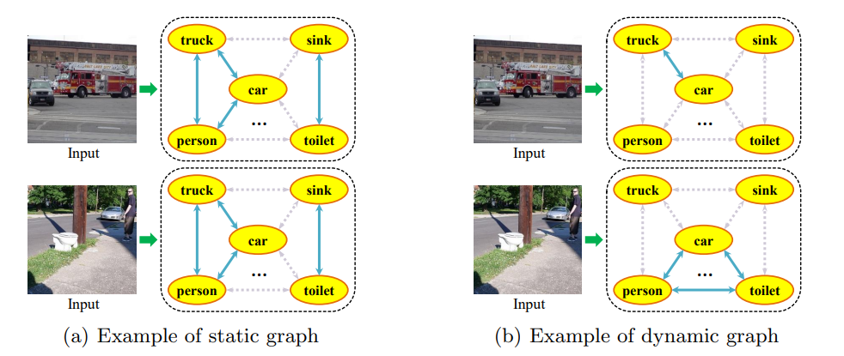
Attention-Driven Dynamic Graph Convolutional Network for Multi-Label Image Recognition
Semantic Attention Module
Dynamic Graph Convolutional Network

Slide 16
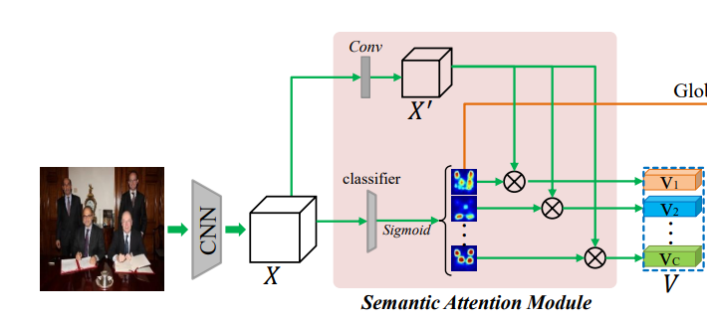
Semantic Attention Module
transformed feature map
category-specific activation maps

Slide 17
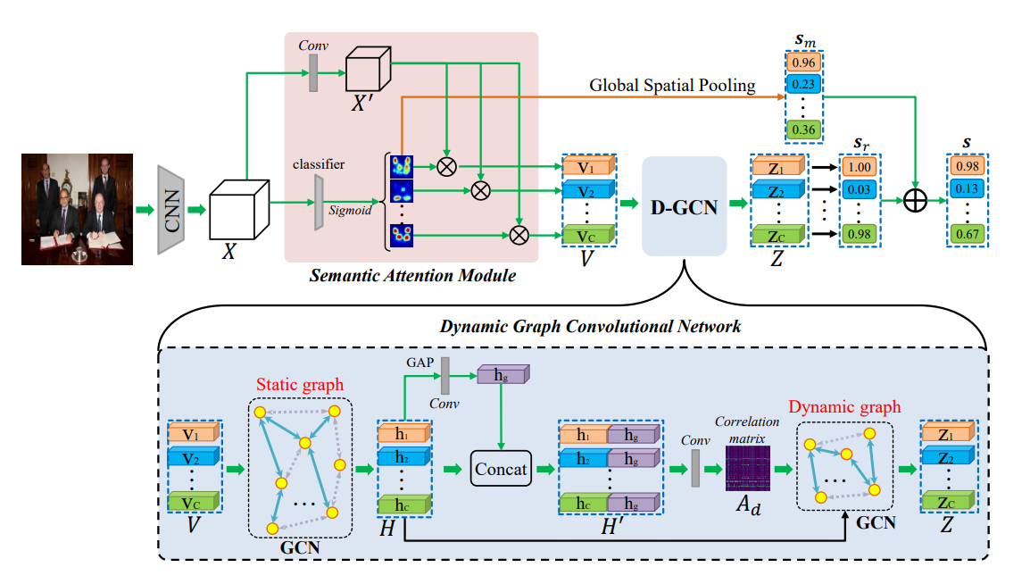
Dynamic Graph Convolutional Network
Dynamic graph, specific for each image.
Static graph, initialize at begin of training.

Slide 18
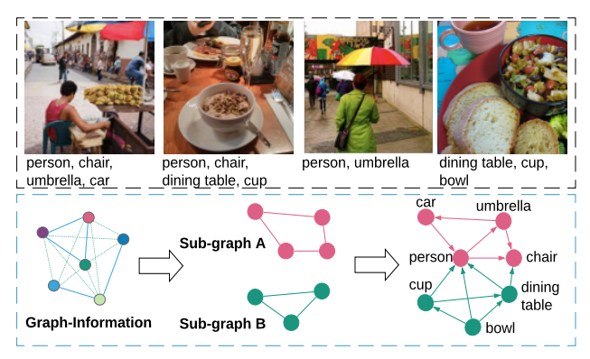
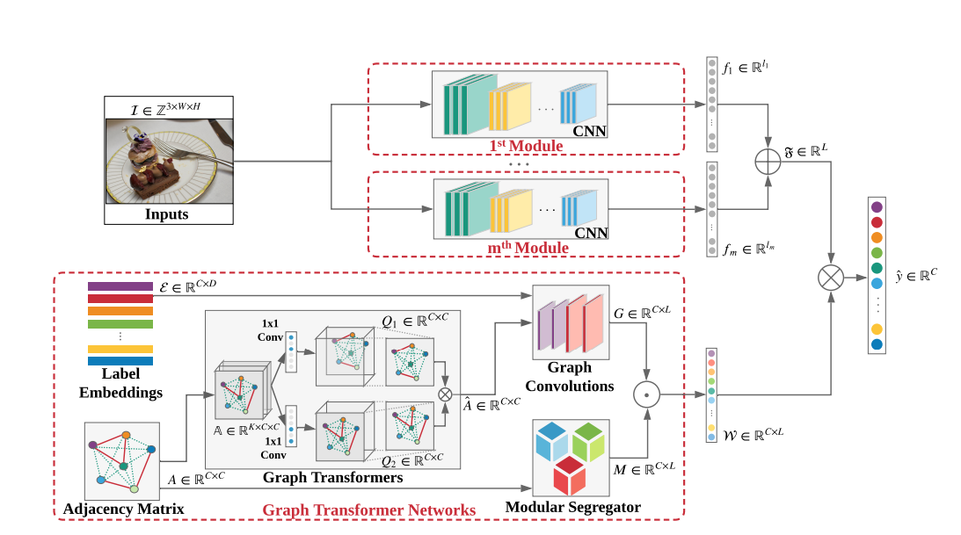
Modular Graph Transformer Networks for Multi-Label Image Classification

Slide 19
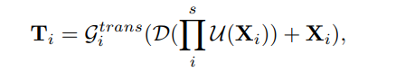
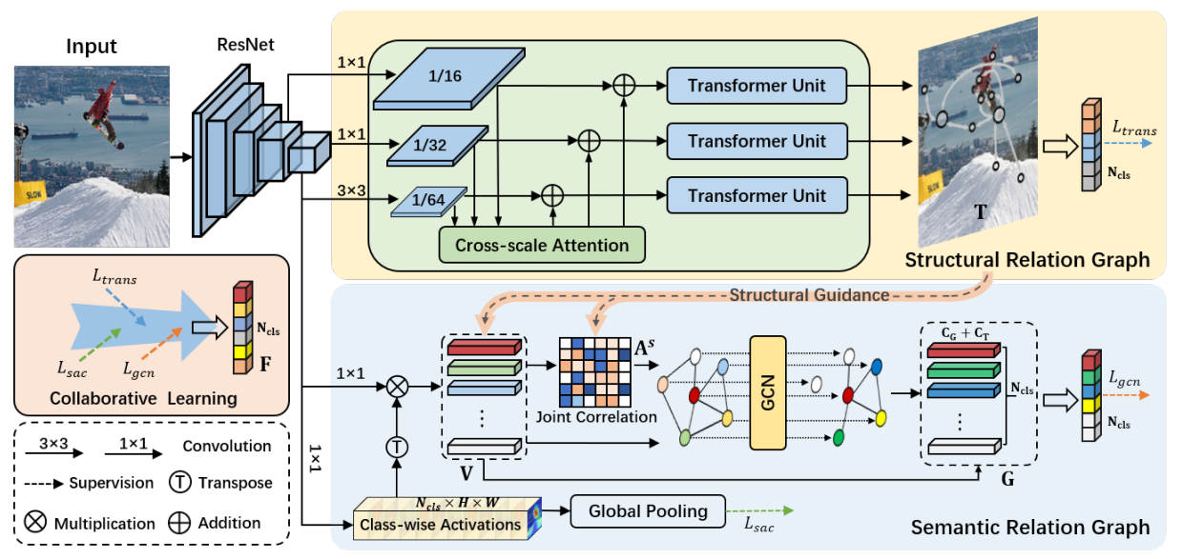
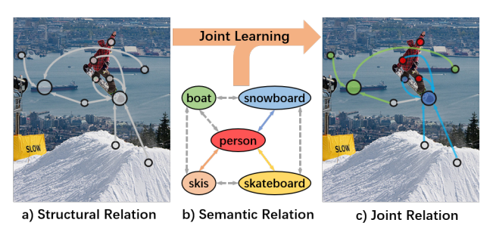
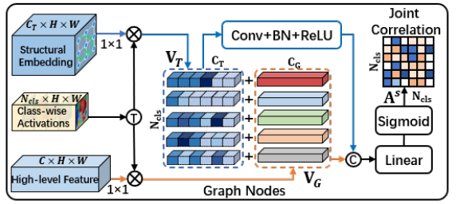
Transformer-based Dual Relation Graph for Multi-label Image Recognition

Slide 20
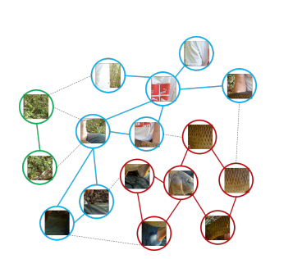
Vision GNN (NeurIPS 2022)
Image to Graph
Architecture

Slide 21
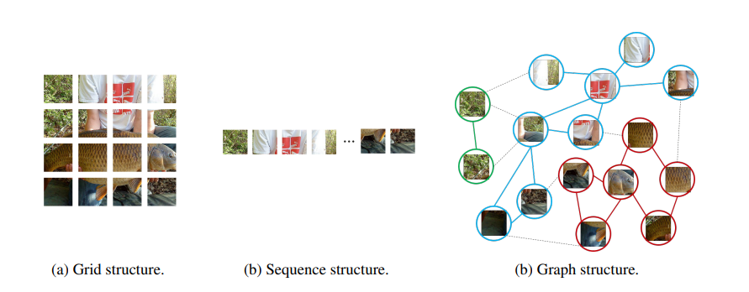
Image to Graph
Using K to limit receptive field in GNN

Slide 22
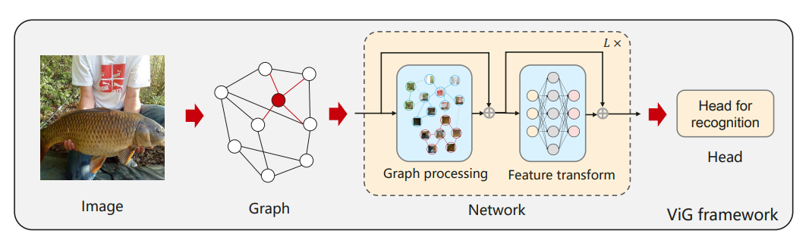
Architecture
Conv->GCN->Conv

Slide 23
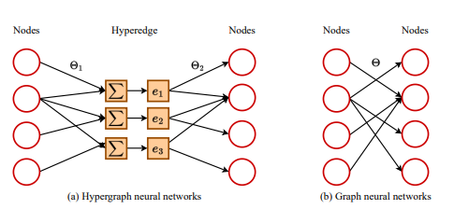
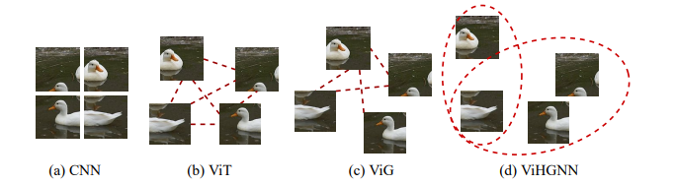
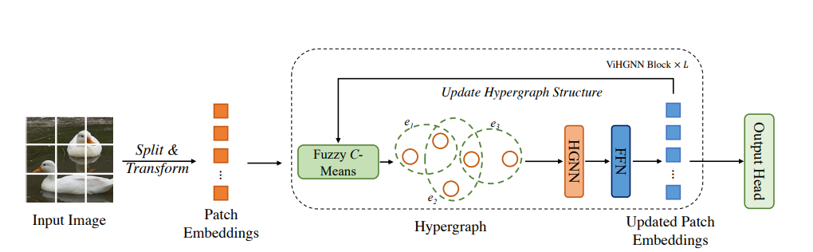
Vision HGNN (ICCV 2023)

Slide 24
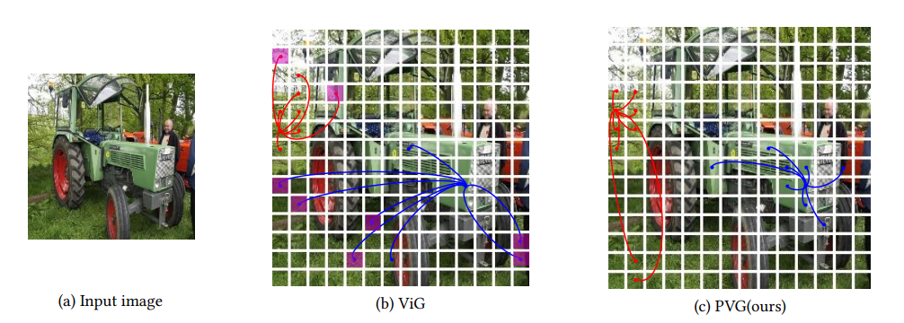
Progressive Vision Graph for Vision Recognition (ACMMM 2023)
Progressive Separated Graph Construction
MaxE
GraphLU
Architecture

Slide 25
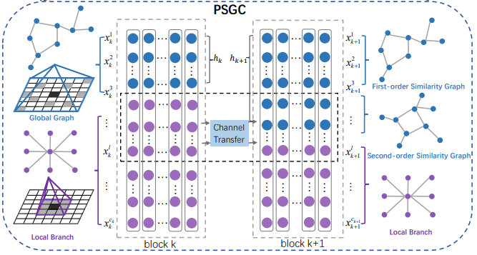
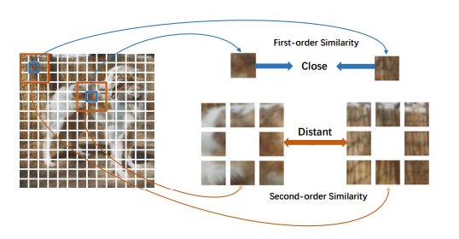
Progressive Separated Graph Construction
In early stage of network, these channels using for Local Branch. Then transfer to Global Branch for get Second-order Similarity in later stage.

Slide 26
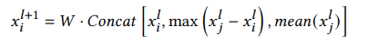
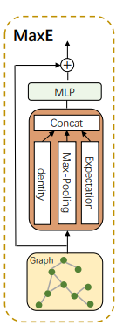
MaxE
Identity
Max-Pooling: get information from the point with the maximum difference from the central node.
Expectation: get information from mean point.

Slide 27
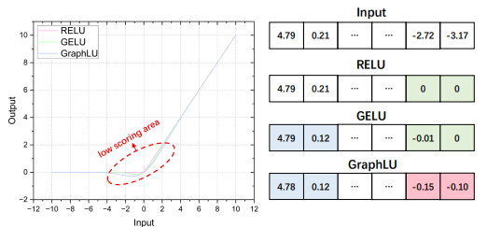
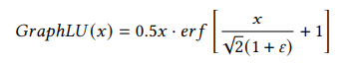
GraphLU
GraphLU follows the principle of GELU. Add a small perturbation to variance of the random variable X, for amplify detail information.

Slide 28
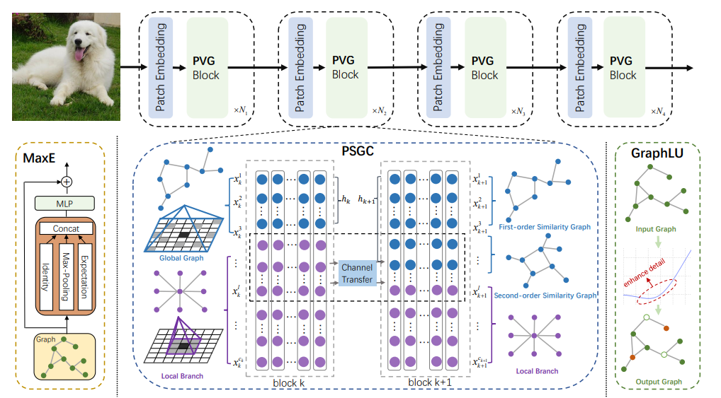

Architecture

